Slide 1

Academic Affairs
FY 2024 Planning and Budget Meeting

Slide 2
Office of the Provost
  Academic Planning & Assessment
    SACSCOC
  Research & Sponsored Programs
    EURECA
    TRIES
    TISI
    Vivarium
  SHSU Online
  Graduate & Professional School
  Community Engagement
    The Woodlands Center
    Center for Community Engagement
    Center for Law, Engagement, And Politics
  Faculty Success
  Academic Communications
  Faculty Records & Reporting
  Faculty Senate Support
  Vice Provost
    Student Success
      Academic Success Center
      First-Year Experience
      First-Generation Center
      ELITE and evolve
      Global Engagement Center
      Academic Advising & Career Success (June 1)
    Faculty Success
      Professional & Academic Center for Excellence
    Newton Gresham Library
    Honors College
    Strategic Initiatives
    Transfer Partnerships and Early College Credit
    Military Science
    Smith-Hutson Scholars Program
    Faculty/Staff Ombuds

Slide 3

FY 2023 Accomplishments
Priority 1: Prioritize Student Success and Student Access
UNIV 2001 for Probation: 79% persistence vs. 67% control
UNIV 3001 for Suspension: 84% persistence vs. 58% control
FGC: 1,165 mentoring appointments w/ staff
  Peer mentor pilot (N=17): 94% persistence and 3.1 GPA
  14 events w/ 678 first gen students for Natl. First Gen Week
Global Ed Ctr: 119 study abroad (96 w/ scholarships)
$402,811* for ASC & FYE
$83,000 for FGC

Slide 4
FY 2023 Accomplishments
Priority 2: Embody a Culture of Excellence
  Academic Excellence
  Faculty Research in External Funding
    R2 status
  Provost Innovation Fund
  BRIDGE - $500,000
    Signature interdisciplinary research initiatives
    Leverage external funding

Slide 5
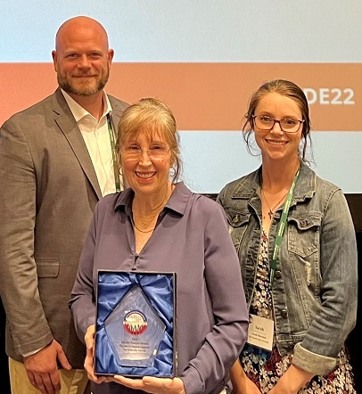

FY 2023 Accomplishments
Priority 3: Elevate the Reputation and Visibility of SHSU
Priority 4: Expand and Elevate our Service to the State and Beyond
National leader in community engagement
+862

Slide 6
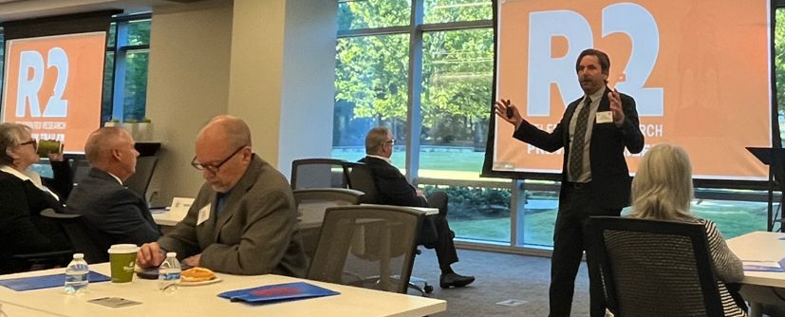
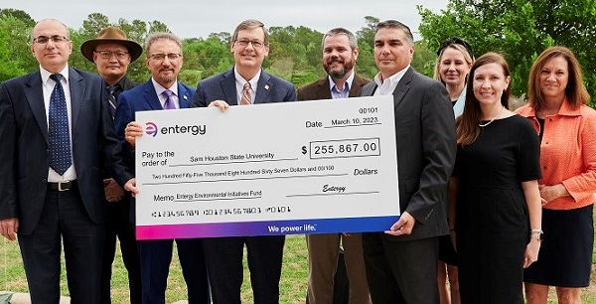
FY 2023 Accomplishments
Priority 3: Elevate the Reputation and Visibility of SHSU
Priority 4: Expand and Elevate our Service to the State and Beyond
Strategic use of TWC as hub for engagement, visibility
ORSP & Economic Development
Elevate leadership in academic community engagement
Notes:
Entergy Partnership with COSET Engr Tech – EV charging station on I-45
COE Ed Aide program – awarded $342k from Temple Foundation to build teacher capacity

Slide 7
Budget Request
#1 Budget Priority | Student Success Staff
Aligned with Strategic Priority Goal | Priority 1: Student success and student access
Amount Requested | $360,160
Frequency of Need | Recurring
Opportunity Statement | Three key student success positions that are currently funded on grants that are expiring or are on one-time funds; establishes that the #1 priority for AA is student success.
Risk Statement | These positions are relatively new. Enrollment drops as do persistence and retention.

Slide 8
Supportive Data
AVP for Student Success [one-time funds]
  Academic Success Center (23,000 check-ins)
  First-Year Experience (1,207 students 2x week)
  First-Generation Center (1,165 one-on-one appointments this year)
  ELITE and evolve
  Global Engagement Center (119 students abroad)
  Academic Advising & Career Success (June 1)
Assistant Director for ELITE/evolve [Greater Texas Foundation grant]
  245 students with 90% retention
Specialist for Academic Recovery [one-time funds]
  1,469 students in UNIV 2001 (79% retention)
  512 students in UNIV 3001 (84% retention)

Slide 9
Budget Request
#3 Budget Priority
What is the request?
#2 Budget Priority | Scale Up Bearkat U (UNIV 1101)
Aligned with Strategic Priority Goal | Priority 1: Student success and student access
Amount Requested | $142,500 (instructors) + $244,000 (peer mentors)
Frequency of Need | Recurring
Opportunity Statement | Allows 1,900 more freshman and transfer students to enroll in UNIV 1101.
Risk Statement | By not scaling up, we risk losing students in whom we have invested.

Slide 10
Supportive Data
Bearkat U (UNIV 1101) Fall 2021 to Fall 2022 Retention
  All First-Time Freshmen:
    79.8% vs. 71.6% for non-participants
  First Generation First-Time Freshmen:
    81.4% vs. 71.7% for non-participants

Slide 11
Budget Request
#2 Budget Priority
What is the request?
#3 Budget Priority | Assistant Director, Center for Community Engagement
Aligned with Strategic Priority Goal | Priority 1: Student success and student access Priority 4: Expand and elevate our service to the state and beyond
Amount Requested | $84,200
Frequency of Need | Recurring
Opportunity Statement | Continuously growing demand for community engagement support requires full-time supervisory support for the center. Current directors are half-time.
Risk Statement | Inability to meet increasing needs for community engagement support for students, faculty, staff, administration, and community members.

Slide 12
Supportive Data

Slide 13
Budget Request
#4 Budget Priority
What is the request?
#4 Budget Priority | Academic Advisors
Aligned with Strategic Priority Goal | Strategic Priority 1: Student success and student access
Amount Requested | $471,240 (professional staff) + $147,840 (faculty course release)
Frequency of Need | Recurring
Opportunity Statement | Academic advising provides students with structure to complete their degrees in a timely manner, reducing the need for loans; critical part of our wrap-around philosophy.
Risk Statement | Students are not able to see an advisor, take the wrong classes, delay graduation, and potentially increase debt.

Slide 14
Budget Request
#5 Budget Priority
What is the request?
#5 Budget Priority | Promotion and Tenure Salary Adjustments
Aligned with Strategic Priority Goal | Strategic Priority 2: Embody a culture of excellence (academic excellence)
Amount Requested | $38,020
Frequency of Need | Recurring
Opportunity Statement | Presents an opportunity to retain our best faculty.
Risk Statement | Faculty members seek out other positions with larger salaries and leave the institution.

Slide 15
Summary of Budget Requests
Student success staff – $360,160
Scale Up UNIV 1101 – $386,500
3. Asst. Director, Community Engagement – $84,200
4. Academic Advisors – $619,080
5. Promotion & Tenure Salary Adjustments – $ 38,020
*Total Amount Requested – $1,487,960

Slide 16
Self-funded New Initiatives
List here new initiatives that expect to fund in FY 2024 using your existing budget. Please include the Strategic Priority that they support below each one.
    $100,000 one-time funds for Center for Community Engagement (SP4, SP1)
    $500,000 in one-time for Provost Innovation Fund (SP2)
    $35,000 in O&M for Smith-Hutson (SP 1)

Slide 17
Prospective “Big Ideas”
List here any “big ideas” that you are thinking about within the next 2-5 years for your college/division. These are “brainstorm” level ideas.
New off-site campus in New Caney for teaching, recruiting, health professions coursework, and a research think-tank

Slide 18
Questions?

